Slide 1
Session 04 : Android Environment Emulator
Module 4.3 : Android

Slide 2
Learning Objectives
At the end of the session successful participants will be able to
Describe Android Emulator
Use Emulator
Create AVD

Slide 3
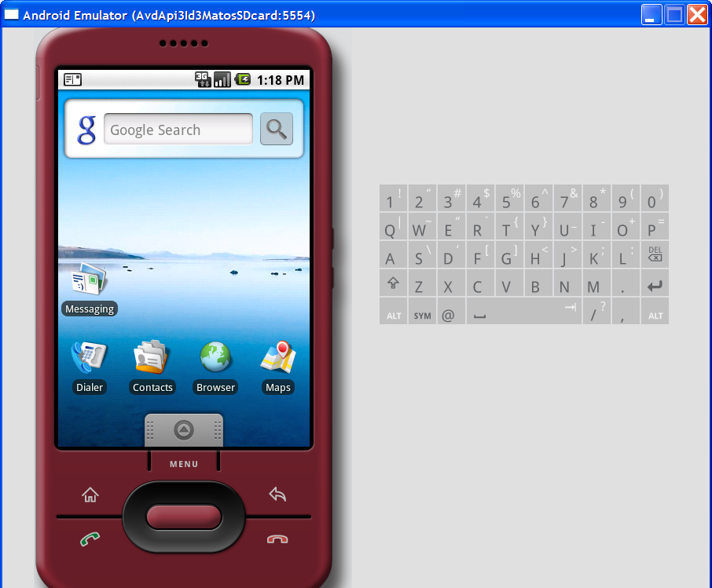
Android Environment Emulator
Android Emulator
The Android SDK includes a mobile device emulator - a virtual mobile device that runs on your computer.

Slide 4
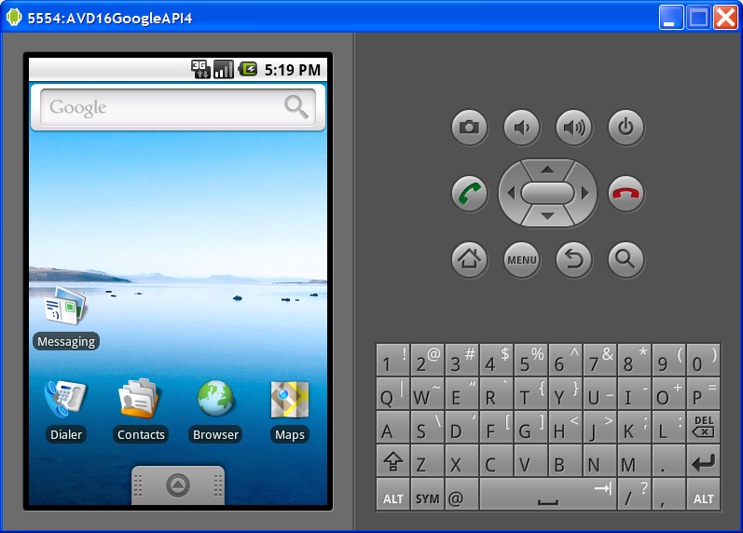
Android Environment Emulator
Android Emulator
The emulator lets you prototype, develop, and test Android applications without using a physical device.
The Android emulator mimics all of the hardware and software features of a typical mobile device, except that it cannot receive or place actual phone calls.

Slide 5
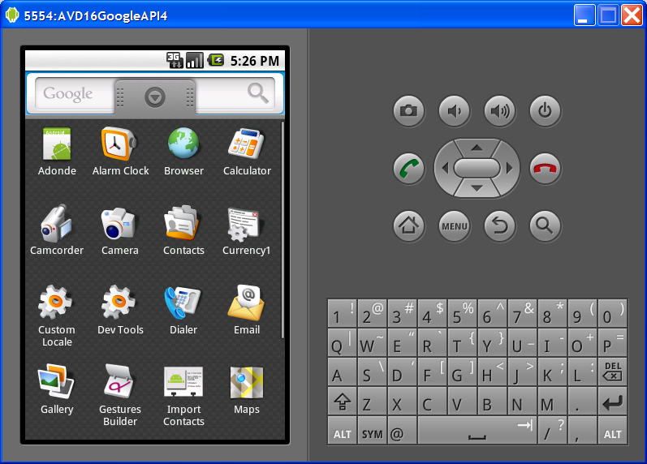
Android Environment Emulator
Android Emulator
It provides a variety of navigation and control keys, which you can "press" using your mouse or keyboard to generate events for your application.
It also provides a screen in which your application is displayed, together with any other Android applications running.

Slide 6
Android Environment Emulator
Android Emulator v1.5 Skin
Status Bar – Notification Line
Power
Volume
Tab Launch
Pad
Menu
Home
Back
Call
Hang up

Slide 7
Android Environment Emulator
Android Emulator v1.6 Skin
Status Bar – Notification Line
Power
Volume
Call
Hang up
Home
Menu
Back
Tab Launch
Pad

Slide 8
Android Environment Emulator
Android Emulator v1.6 Skin
Status Bar – Notification Line
Tab Launch
Pad
Power
Volume
Call
Hang up
Home
Menu
Back

Slide 9
Android Environment Emulator
Android Emulator
Keyboard | OS Function
Escpe | Back button
Home | Home button
F2, PageUp | Menu (Soft-Left) button
Shift+F2, PageDown | Start (Soft-Right) button
F3 | Call/Dial button
F4 | Hangup / EndCall button
F5 | Search button
F7 | Power button
Ctrl-F3, Ctrl-KEYPAD_5 | Camera button
Ctrl-F5, KEYPAD_PLUS | Volume up button
Ctrl-F6, KEYPAD_MINUS | Volume down button
KEYPAD_5 | DPad center
KEYPAD_4 | DPad left
KEYPAD_6 | DPad right
KEYPAD_8 | Dpadup
KEYPAD_2 | DPad down
F8 | toggle cell network on/off
F9 | toggle code profiling (when-trace option set)
Alt-ENTER | toggle FullScreen mode
Ctrl-T | toggle trackball mode
Ctrl-F11, KEYPAD_7 | switch to previous layout
Ctrl-F12, KEYPAD_9 | switch to next layout
Deactivate the NumLock keys and Control the Android Emulator following keyboards keys.

Slide 10
Android Environment Emulator
Android Emulator
Features – Emulating First Generation Android Phones
The Android emulator supports many hardware features likely to be found on mobile devices (such as the HTC-G1), including:
An ARMv5 CPU and the corresponding memory-management unit (MMU)
A 16-bit LCD display (mimicking 360 x 480 pixels)
One or more keyboards (a Qwerty-based keyboard and associated Dpad/Phone buttons)

Slide 11
Android Environment Emulator
Android Emulator
Features – Emulating First Generation Android Phones
The Android emulator supports many hardware features likely to be found on mobile devices (such as the HTC-G1), including:
A sound chip with output and input capabilities
Flash memory partitions (emulated through disk image files on the development machine)
A GSM modem, including a simulated SIM Card

Slide 12
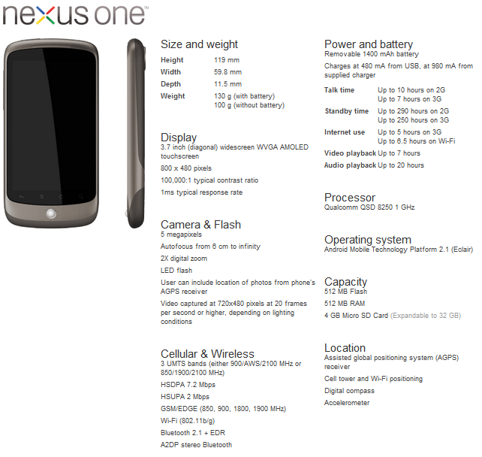
Android Environment Emulator
Android Emulator
Neus One

Slide 13
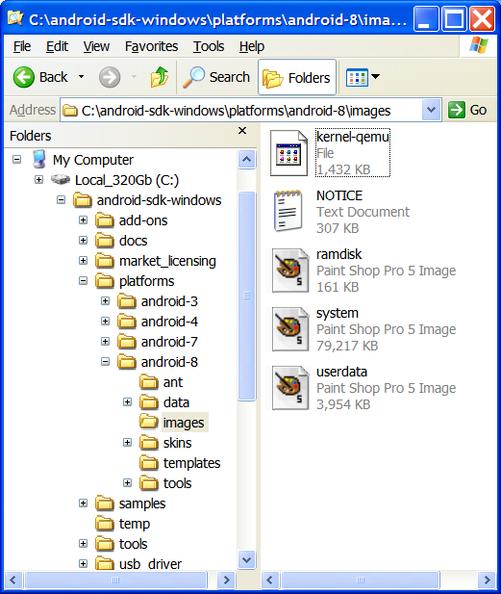
Android Environment Emulator
Android Emulator
Working with Emulator Disk Images
The emulator uses mountable disk images (ANDROID SYSTEM IMAGE) stored on your development machine to simulate flash (or similar) partitions on an actual device.

Slide 14
Android Environment Emulator
Android Emulator
Working with Emulator Disk Images
For example, it uses disk images containing:
An emulator-specific kernel
The Android system
A ram-disk image
Writeable images for user data and simulated SD card

Slide 15
Android Environment Emulator
Android Emulator
Working with Emulator Disk Images
By default, the Emulator always looks for the disk images in the private storage area of the AVD in use (c:\android-sdk-windows\platform\…)

Slide 16
Android Environment Emulator
Android Emulator
Working with Emulator Disk Images
If no platform images exist there when the Emulator is launched, it creates the images in the AVD directory based on default versions stored in the SDK.

Slide 17
Android Environment Emulator
Android Emulator
Working with Emulator Disk Images
Note: The default storage location for AVDs is in ~/.android/avdon OS X and Linux, C:\Documents and Settings\<user>\.android\avd\... on Windows XP, and C:\Users\<user>\.android\on Windows Vista.

Slide 18
Android Environment Emulator
Android Emulator
Creating an AVD using the android tool: Listing targets
To generate a list of system image targets, use these commands:
C:\Documents and Settings\Administrator\.android\avd\AVD22GoogleAPI8.avd>a
Available Android targets:
id: 1 or "android-3"
Name: Android 1.5
Type: Platform
API level: 3
Revision: 4
Skins: HVGA (default), HVGA-L, HVGA-P, QVGA-L, QVGA-P
id: 2 or "Google Inc.:GoogleAPIs:3"
Name: Google APIs
Type: Add-On

Slide 19
Android Environment Emulator
Android Emulator
Creating an AVD using the android tool: Listing targets
To generate a list of system image targets, use these commands:
Vendor: Google Inc.
Revision: 3
Description: Android + Google APIs
Based on Android 1.5 (API level 3)
Libraries:
* com.google.android.maps(maps.jar)
API for Google Maps
Skins: QVGA-P, HVGA-L, HVGA (default), QVGA-L, HVGA-P
id: 3 or "android-4“
Name: Android 1.6
Type: Platform
API level: 4

Slide 20
Android Environment Emulator
Android Emulator
Creating an AVD using the android tool: Listing targets
To generate a list of system image targets, use these commands:
Revision: 3
Skins: HVGA (default), QVGA, WVGA800, WVGA854
id: 4 or "Google Inc.:GoogleAPIs:4"
Name: Google APIs
Type: Add-On
Vendor: Google Inc.
Revision: 2
Description: Android + Google APIs
Based on Android 1.6 (API level 4)
Libraries:
* com.google.android.maps(maps.jar)
API for Google Maps

Slide 21
Android Environment Emulator
Android Emulator
Creating an AVD using the android tool: Listing targets
To generate a list of system image targets, use these commands:
Skins: WVGA854, HVGA (default), WVGA800, QVGA
id: 5 or "android-7"
Name: Android 2.1-update1
Type: Platform
API level: 7
Revision: 2
Skins: HVGA (default), QVGA, WQVGA400, WQVGA432, WVGA800, WVGA854
id: 6 or "Google Inc.:GoogleAPIs:7"
Name: Google APIs
Type: Add-On
Vendor: Google Inc.

Slide 22
Android Environment Emulator
Android Emulator
Creating an AVD using the android tool: Listing targets
To generate a list of system image targets, use these commands:
Revision: 1
Description: Android + Google APIs
Based on Android 2.1-update1 (API level 7)
Libraries:
* com.google.android.maps(maps.jar)
API for Google Maps
Skins: WVGA854, WQVGA400, HVGA (default), WQVGA432, WVGA800, QVGA
id: 7 or "android-8"
Name: Android 2.2
Type: Platform
API level: 8

Slide 23
Android Environment Emulator
Android Emulator
Creating an AVD using the android tool: Listing targets
To generate a list of system image targets, use these commands:
Revision: 2
Skins: HVGA (default), QVGA, WQVGA400, WQVGA432, WVGA800, WVGA854
id: 8 or "Google Inc.:GoogleAPIs:8"
Name: Google APIs
Type: Add-On
Vendor: Google Inc.
Revision: 2
Description: Android + Google APIs
Based on Android 2.2 (API level 8)

Slide 24
Android Environment Emulator
Android Emulator
Creating an AVD using the android tool: Listing targets
To generate a list of system image targets, use these commands:
Libraries:
* com.google.android.maps(maps.jar)
API for Google Maps
Skins: WVGA854, WQVGA400, HVGA (default), WQVGA432, WVGA800, QVGA

Slide 25
Android Environment Emulator
Android Emulator
Starting – Stopping the Emulator
To start an instance of the emulator from the command line, change to the tools/ folder of the SDK. Enter emulator command like this:
emulator -avd<avd_name>
This initializes the emulator and loads an AVD configuration.
After a few seconds you will see the emulator window appear on your screen.

Slide 26
Android Environment Emulator
Android Emulator
Starting – Stopping the Emulator
If you are working in Eclipse, the ADT plug-in for Eclipse installs your application and starts the emulator automatically, when you run or debug the application.
To stop an emulator instance, just close the emulator's window.
To list all available AVDs enter DOS command
android list avd

Slide 27
Android Environment Emulator
Android Emulator
AVD – Android Virtual Device
Android Virtual Devices (AVDs) are configurations of emulator options that let you better model an actual device.
Each AVD is made up of:
A hardware profile. You can set options to define the hardware features of the virtual device. For example, you can define whether the device has a camera, whether it uses a physical QWERTY keyboard or a dialing pad, how much memory it has, and so on.
A mapping to a system image. You can define what version of the Android platform will run on the virtual device. You can choose a version of the standard Android platform or the system image packaged with an SDK add-on.

Slide 28
Android Environment Emulator
Android Emulator
AVD – Android Virtual Device
Each AVD is made up of:
Other options. You can specify the emulator skin you want to use with the AVD, which lets you control the screen dimensions, appearance, and so on. You can also specify the emulated SD card to use with the AVD.
A dedicated storage area on your development machine, in which is stored the device's user data (installed applications, settings, and so on) and emulated SD card.
You can create as many AVDs as you need, based on the types of devices you want to model and the Android platforms and external libraries you want to run your application on.

Slide 29
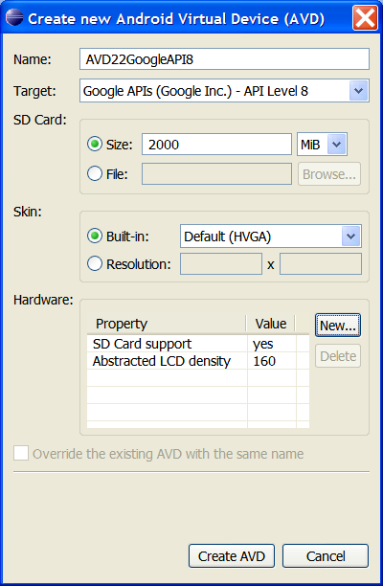
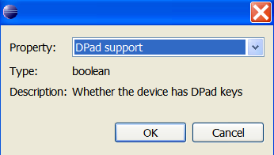
Android Environment Emulator
Android Emulator
Creating an AVD using the Eclipse - ADT Tool: From the Eclipse follow the sequence:
Main menu (AVD Manager)> Virtual Devices > New >
Provide a Name
choose an Android target
create a new SD card with about 2Gb
choose a screen type
add hardware devices…
Click on: Create AVD (wait, it takes several minutes to format the new SD card)

Slide 30
Android Environment Emulator
Android Emulator
Creating an AVD using the Android tool
When creating an AVD, you simply specify the –c option, like this:
android create avd-n <avd_name> -t <targetID> -c <size>[K|M]
The –t (target) argument sets up a mapping between the AVD and the system image that you want to use whenever the AVD is invoked. Later, when applications use the AVD, they'll be running on the system that you specify in the –t argument.
To specify the system image to use, you refer to its target ID—an integer —as assigned by the android tool. The target ID is not derived from the system image name, version, or API Level, or other attribute, so you need to have the android tool list the available system images and the target ID of each, as described in the next section. You should do this before you run the android create AVD command.

Slide 31
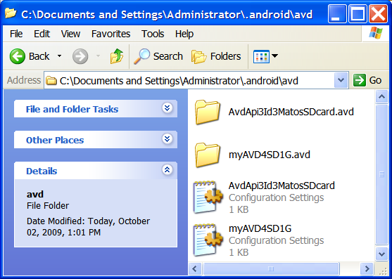
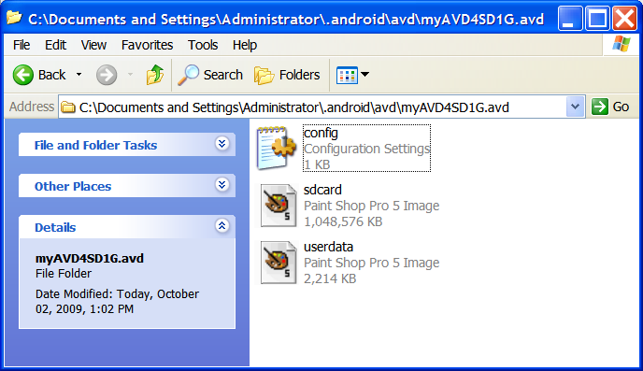
Android Environment Emulator
Android Emulator
Example: Creating an AVD using the Android tool
After listing all targets we have decided to make a profile based on target id:4 to support SDK1.6 with Google API Mapping libraries. It should also include a 1Gig SD card. We enter the following command:
android create avd-n myAVD4SD1G -t 4 -c 1024M

Slide 32
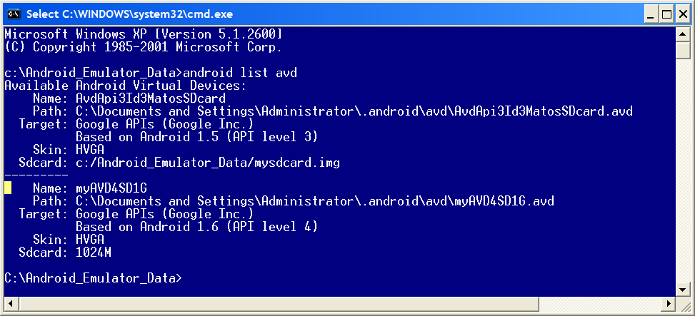
Android Environment Emulator
Android Emulator
Example: Creating an AVD using the Android tool
Verifying what AVDs are available in the system:

Slide 33
Android Environment Emulator
Android Emulator
SD Card Emulation
You can create a disk image and then load it to the emulator at startup, to simulate the presence of a user's SD card in the device.
The emulator supports emulated SDHC cards, so you can create an SD card image of any size up to 128 giga-bytes.
You can browse, send files to, and copy/remove files from a simulated SD card either with adb or the emulator.

Slide 34
Android Environment Emulator
Android Emulator
SD Card Emulation
Creating an SD card image using mksdcard - Use the mksdcard tool, included in the SDK, to create a FAT32 disk images.
mksdcard<size> <file>
For example:
mksdcard1024M c:/temp/mysdcard.iso

Slide 35
Android Environment Emulator
Android Emulator
Android Emulator – How to use the SDcard device?
The general syntax to create an SDcard is:
ismksdcard[ -l label ] <size> <file>
The tool mksdcard is part of the Android SDK. The SD label is optional.
The device’s size is expressed as an integer number followed by either K(kilobytes) or M(megabytes).

Slide 36
Android Environment Emulator
Android Emulator
Android Emulator – How to use the SDcard device?
Create a 1GB SDcard device using the following:
mksdcard1024M c:\mysdcard.img
Run the emulator with the command
emulator -sdcardc:\mysdcard.img
Or, alternatively emulator
alternativelyemulator -avdmyAvdFile

Slide 37
Android Environment Emulator
Android Emulator
Moving Data, Music and Pictures to the SDcard
Use the program ddms to push files into the SDcard (the emulator must be running with the SD card attached to it).
Click on: Device > File Explorer, this will open a new window and there you will select the SDcard.
Now you move data to the SDcard. Your options are
Open a Windows Explore panel to drag & drop files/folders on the card, or
Press on the button "Push File onto Device" (see icons: push, pull, delete).
Note: (DDMS stands for Dalvik Debug Monitor Services. The program is located in the /tools folder of the SDK and in Eclipse perspective

Slide 38
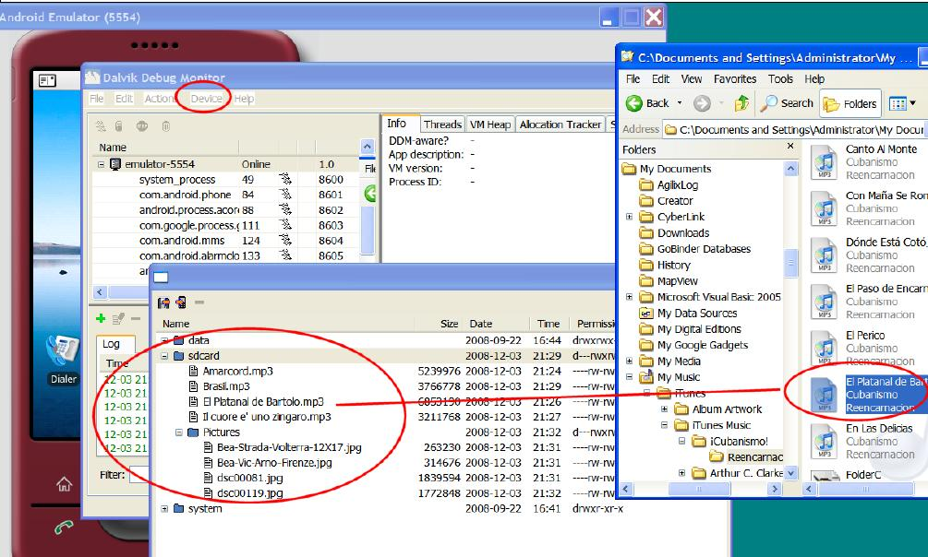
Android Environment Emulator
Android Emulator
Moving Data, Music and Pictures to the SDcard

Slide 39
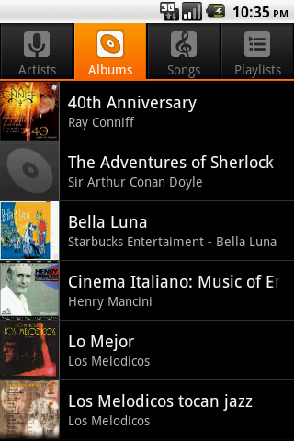


Android Environment Emulator
Android Emulator
Moving Data, Music and Pictures to the SDcard
Return to the emulator. This time you will see the selected (music) files in the SDcard

Slide 40
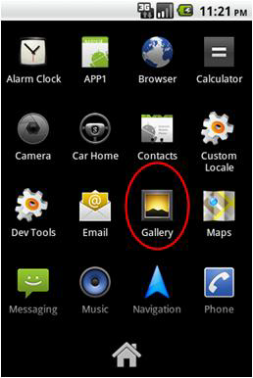


Android Environment Emulator
Android Emulator
Moving Data, Music and Pictures to the SDcard
Pictures appear by clicking the Application Pad and invoking the Gallery application

Slide 41
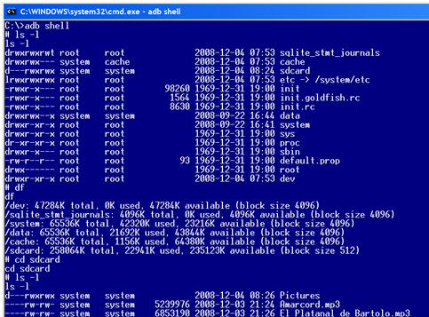
Android Environment Emulator
Android Emulator
Android – Login into the OS shell
You can log into the OS Linux version of Android executing in the emulator and issue selected commands.
Run the Android emulator
Run adb application as follows: c:> adbshell
Note: (adb is the Android Debug Bridge app. It is Located in the /tools folder of the SDK)

Slide 42
Android Environment Emulator
Android Emulator
Android – Login into the OS shell
If more than one emulator is running (or your phone is physically connected to the computer using the USB cable) you need to identify the target.

Slide 43
Android Environment Emulator
Android Emulator
Android – Login into the OS shell
If more than one emulator is running (or your phone is physically connected to the computer using the USB cable) you need to identify the target.
Get a list of all active emulators
adb devices
List of devices attached
emulator-5554 device
emulator-5556 device
HT845GZ45737 device

Slide 44
Android Environment Emulator
Android Emulator
Android – Login into the OS shell
If more than one emulator is running (or your phone is physically connected to the computer using the USB cable) you need to identify the target.
Run adb application as follows:
adb-s emulator-5554 shell
Note: (adb is the Android Debug Bridge app. It is Located in the /tools folder of the SDK)

Slide 45
Android Environment Emulator
Android Emulator
Note1 – Emulators & Hardware Devices
You may test your applications in either a software emulator or a hardware device:
Connect your phone to the computer via USB cable
On a command shell type the command:
Adbdevices
you should see something like “HT845GZ45737 device” indicating the presence of your hardware device.

Slide 46
Android Environment Emulator
Android Emulator
Note1 – Emulators & Hardware Devices
Gaining Root Access to Your Hardware deviceA developer’s phone such as the G1 comes with root access enabled and is fully opened.
Run the terminal application (adbshell) and see if you have the # prompt; if not try the command su. It should give you the root prompt, if you have a permission denied error then you do not have root access.

Slide 47
Android Environment Emulator
Android Emulator
Note2 – Moving an app from (Rooted) Hardware to Emulator
If you want to transfer an app installed in your developer’s phone to the emulator, follow the next steps:
Run command shell: > adbdevices (find out the id of your hardware, say HT845GZ45737 )
Pull the file from the device to your computer’s file system. Enter the command adb-s HT845GZ45737 pull data/app/theInstalled.apk c:/theInstalled.apk

Slide 48
Android Environment Emulator
Android Emulator
Note2 – Moving an app from (Rooted) Hardware to Emulator
If you want to transfer an app installed in your developer’s phone to the emulator, follow the next steps:
Disconnect your Android phone
Run an instance of the Emulator
Now install the app on the emulator using the command adb-s emulator-5554 install c:\theInstalledApp.apk
You should see a message indicating the size of the installed package, and Success.

Slide 49
Android Environment Emulator
Android Emulator
Android – Login into the OS shell
Android accepts a number of Linux shell commands including the useful set below:
ls................. show directory (alphabetical order)
mkdir.............. make a directory
rmdir.............. remove directory
rm-r .............. to delete folders with files
rm................. remove files
mv................. moving and renaming files
cat ................ displaying short files
cd................. change current directory

Slide 50
Android Environment Emulator
Android Emulator
Android – Login into the OS shell
Android accepts a number of Linux shell commands including the useful set below:
pwd................ find out what directory you are in
df................. shows available disk space
chmod.............. changes permissions on a file
date ............... display date
exit ............... terminate session

Slide 51
Android Environment Emulator
Android Emulator
Android – Login into the OS shell
There is no copy (cp) command in Android, but you could use the cat instead. For instance:
# cat data/app/theInstalledApp.apk > cache/theInstalledApp.apk

Slide 52
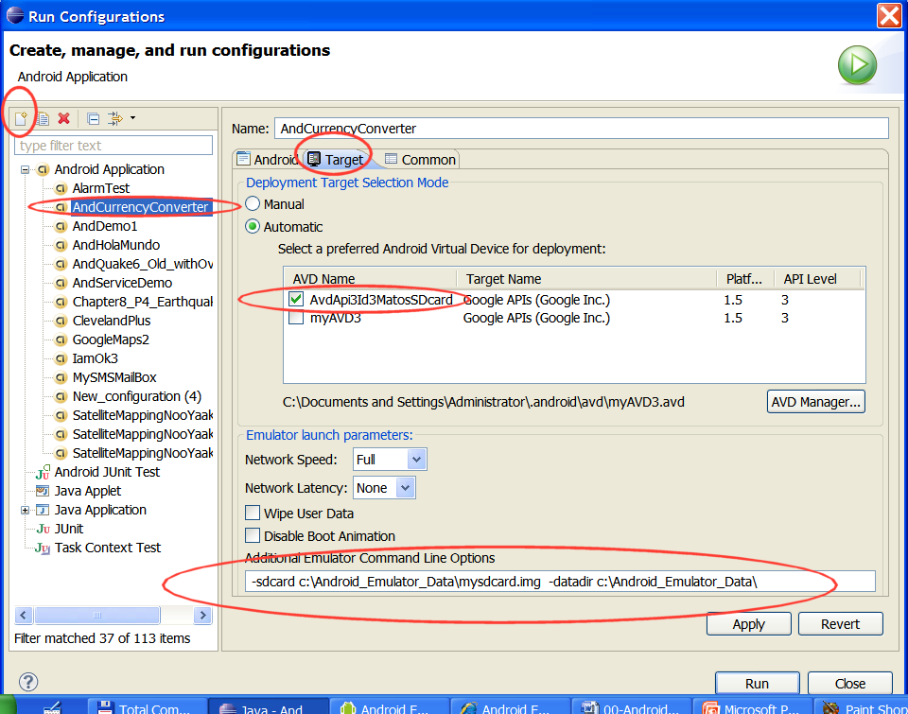
Android Environment Emulator
Android Emulator
Using the Emulator with “inserted” SD card from Eclipse

Slide 53

Android Environment Emulator
Android Emulator
Using the Emulator with “inserted” SD card from Eclipse
From Eclipse’s menu create new launch configuration: Run>Run Configurations > New icon
On Target panel Select existing AVD
Enter additional Command Line Options
Apply > Run
Additional Emulator Command Line Options:-sdcardc:\Android_Emulator_Data\mysdcard.img
datadirc:\Android_Emulator_Data

Slide 54
Android Environment Emulator
Android Emulator
Sending Text Messages to the Emulator
Start the emulator
Open a new shell and type:
c:> adb devices
so you know the emulator’s numeric port id (usually 5554, 5556, and so on)

Slide 55
Android Environment Emulator
Android Emulator
Sending Text Messages to the Emulator
Connect to the console using telnet command like:
c:> telnet localhost 5554
After receiving the telnet prompt you can send a text message with the command (no quotes needed for the message)
sms send <Sender’s phone number> <text message>

Slide 56
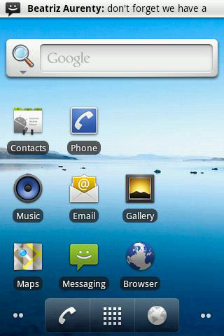
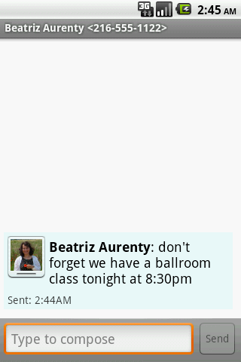
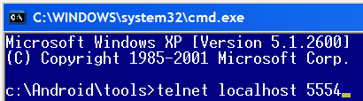
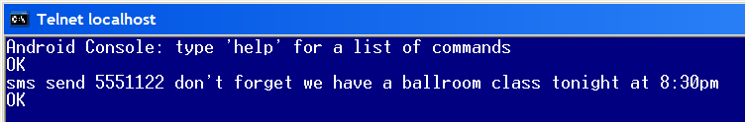
Android Environment Emulator
Android Emulator
Example: Sending Text Messages to the Emulator

Slide 57
Android Environment Emulator
Android Emulator
Making a Voice Call to the Emulator
Start the emulator
Open a new shell and type:
adbdevices
to know the emulator’s numeric port id (usually 5554, 5556, and so on)

Slide 58
Android Environment Emulator
Android Emulator
Making a Voice Call to the Emulator
Connect to the console using telnet command like:
telnet localhost5554 (this is the ‘number’ to be called)
After receiving the telnet prompt you can place a call (voice) with the command
gsmcall <caller’s phone number>

Slide 59

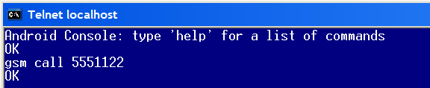
Android Environment Emulator
Android Emulator
Example: Making a Phone Call to the Emulator

Slide 60
Android Environment Emulator
Android Emulator
Emulator Control: Using Eclipse’s DDMS facility
With these controls, you can simulate special device states and activities. Features include:
Telephony Status
Telephony Actions
Location Controls

Slide 61
Android Environment Emulator
Android Emulator
Emulator Control: Using Eclipse’s DDMS facility
Telephony Status
Change the state of the phone's Voice and Data plans (home, roaming, searching, etc.), and simulate different kinds of network Speed and Latency (GPRS, EDGE, UTMS, etc.).

Slide 62
Android Environment Emulator
Android Emulator
Emulator Control: Using Eclipse’s DDMS facility
Telephony Status
Perform simulated phone calls and SMS messages to the emulator.

Slide 63
Android Environment Emulator
Android Emulator
Emulator Control: Using Eclipse’s DDMS facility
Telephony Status
Send mock location data to the emulator so that you can perform location-aware operations like GPS mapping. To use the Location Controls, launch your application in the Android emulator and open DDMS. Click the Emulator Controls tab and scroll down to Location Controls. From here, you can:
Manually send individual longitude/latitude coordinates to the device. Click Manual, select the coordinate format, fill in the fields and click Send.
Use a GPX file describing a route for playback to the device.

Slide 64
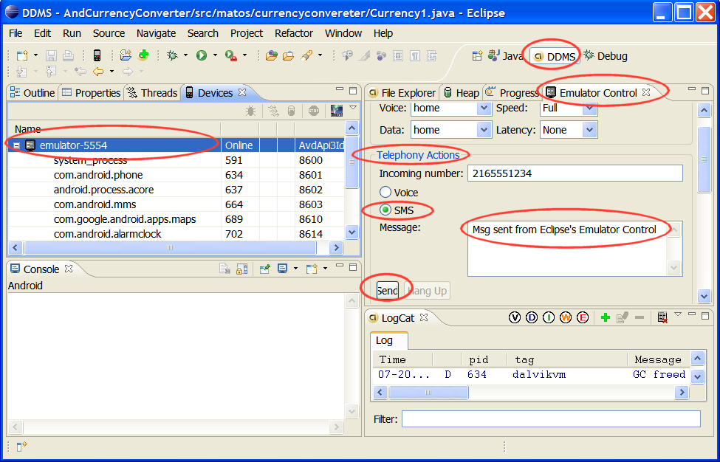
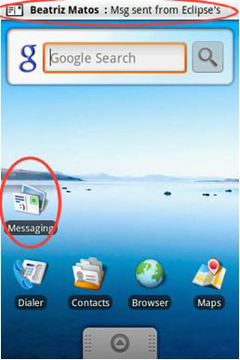
Android Environment Emulator
Android Emulator
Using Eclipse to test Emulator’s Telephony Actions

